Slide 1
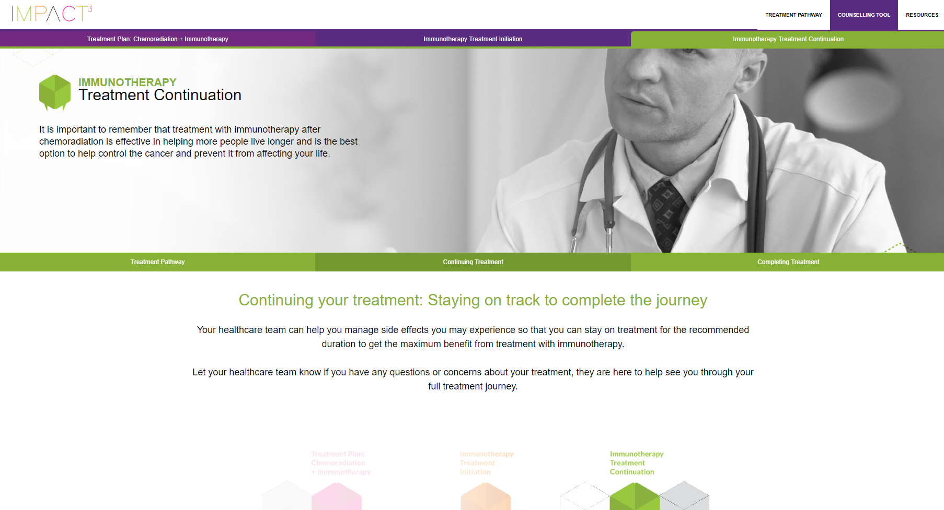
Committing to your two part treatment program is important. You will get the best results from your treatment when you follow your plan completely and on schedule. However staying on track can sometimes be challenging.
Staying on Track with Your Treatment
Below are tips to help you stay on track.
Staying on Track with Appointments
Managing Treatment Schedules
Taking Care of your
Emotional Wellbeing
i
i
i
There are many reasons why some people may not be able to stick with their treatment plan. For example, they may have difficulty getting to and from the treatment centre or they may be feeling a little bit down about their diagnosis and treatment. If you having trouble sticking to your treatment plan, you are not alone – these are common problems.
It is important to take control of your own health. It does not mean doing everything on your own. However it means taking an active role in managing your health on a day-to-day basis, working together with your doctors and nurses.
This includes doing things that will improve your health, such as doing more physical activity and changing your diet. It also includes things you do to look after your lung cancer, such as taking your medicines and attending your appointments – and letting your doctor or nurse know if you notice any changes.

